Slide 1

A presentation on
Personal Budget Tracker
Presented by:
Group No: #08
Md. Tanveer Rana, 193311073
Md. Rafiul Islam, 193311022
Md. Abdul Sefat, 201311138
1
Department of Computer Science and Engineering, Varendra University, Rajshahi

Slide 2
Outline
Introduction
Motivation
Objectives
Requirement analysis
System Description
Tools and Technology
Expected Outcome
Conclusion

Slide 3

Introduction
Project Name : Personal Budget Tracker
Why This Project ?
Key Features :
Record Keeping
Savings Target
Spending Target
Budget Categories
End Of Month Report
Mobile Responsiveness

Slide 4
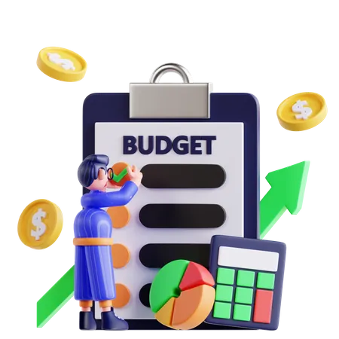
Motivation
Case I:
End of the month money crisis
Case II:
Miscellaneous expenses
Case III:
Lack of proper planning of monthly Budget

Slide 5
Objectives
To Know where the money is going
To spend only on priorities
To save money for pre-defined expenses
To plan on your future investments

Slide 6
Requirement analysis
Functional requirements:
Dashboard Panel
Add Bill
Expense Tracker
Expense Planner
Download Pdf

Slide 7
Requirement analysis
Non-functional requirements:
Usability
Reliability
Supportability
Performance
Availability

Slide 8
System Description
Start
Registration
If already
If not yet Register
Login
Home
Expense
Income
Budget Categories
End

Slide 9

Tools and Technology
Language:
Java
XML.
Database : MySQL
Development Environment:
IDE : Android Studio
OS : Android
SDK: Minimum SDK version 22 (Lollipop 5.1).
Emulator : Android 12
Platform : Android

Slide 10
Expected Outcome
Users have control over their budget
Users will be aware about what is happening with their money
Save funds for emergencies
Aware about the financial condition
No more stress about the finances

Slide 11
Conclusion
This application does more than just track numbers, it authorities users to take command of their financial necessary. Through a simple app, we can provide a personalized and intuitive solution for users seeking financial clarity.

Slide 12
Thank You

